Slide 1



Byte-Pair Encoding
Tokenization
Miftahul Tirta Irawan

Slide 2
1
Training Algorithm
Outline
of
2
Tokenization Algorithm
BPE
3
Implementing BPE

Slide 3
Introduction
What is Byte-Pair Encoding (BPE)?
BPE was an algorithm to compress texts, and then used by OpenAI for tokenization when pre-training the GPT model.
Why is it used for tokenization rather than texts compression?
There are several reasons, which are:
Capability to handling unknown words.
Efficient, remain consistent and reliable.
Flexibility in combining both tokens that encode single char or whole words.
Coverage.
The idea is to divide words into a sequence of subword units → which units that appear frequently in a reference corpus.

Slide 4
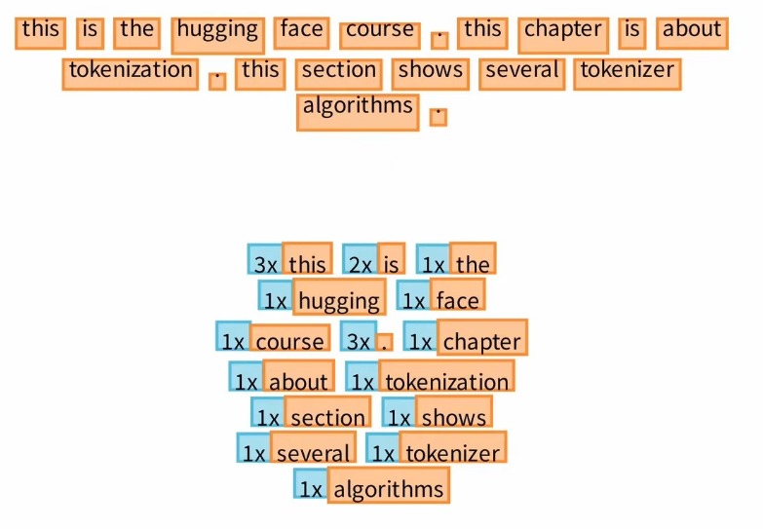
Training Preparation
BPE training starts by computing the unique set of words used in the corpus after the normalization and pre-tokenization steps are completed.

Slide 5
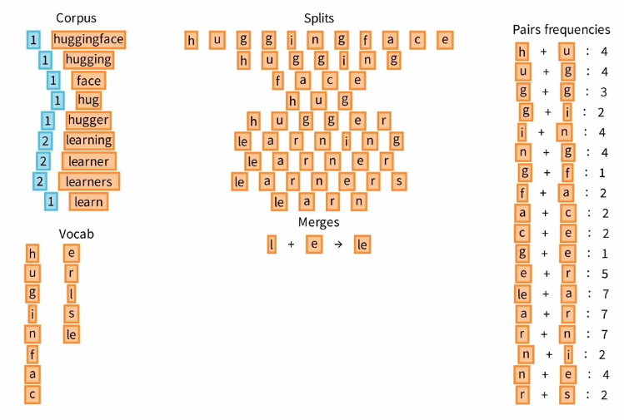
Training Algorithm

Slide 6
Demo

